Slide 1
School and weather
황준화

Slide 2
As known as Korea has four season.

Slide 3
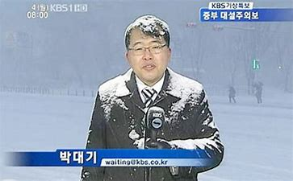
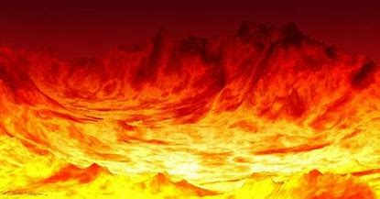
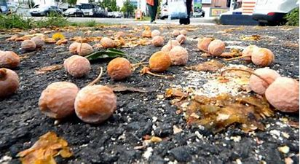
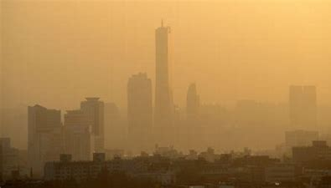
Spring, Summer, fall and winter

Slide 4
Each seasons are very different.

Slide 5
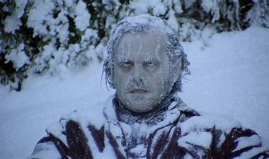
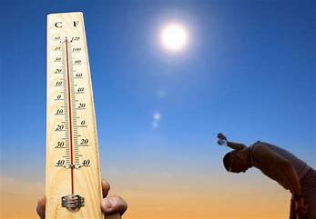
Someday is hot or cold,

Slide 6
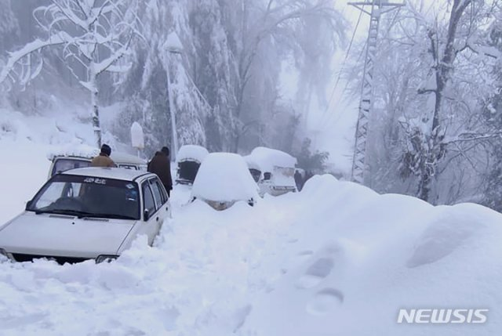
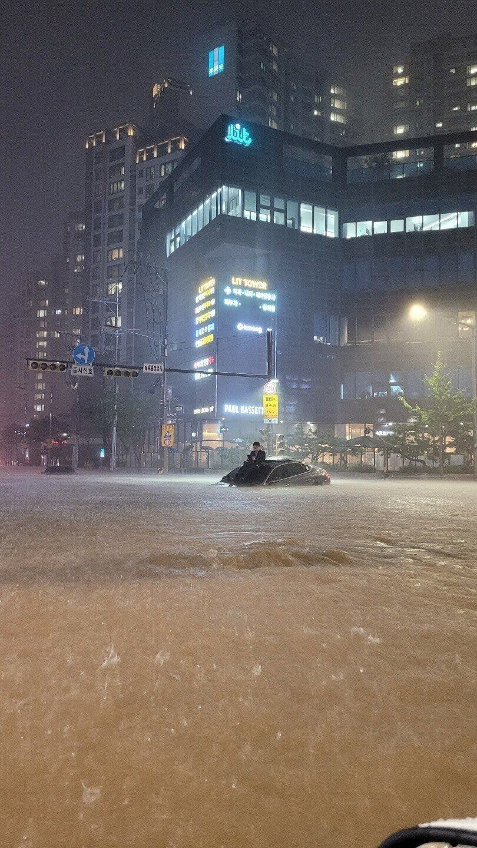
Someday is raining or snowing.

Slide 7
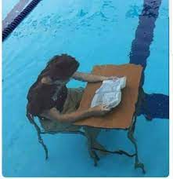
In summer, it’s hot and humid so smells terrible in sewer

Slide 8



If you try to breath fresh air in winter,

Slide 9
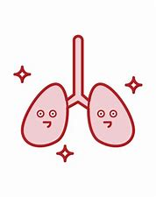

Your lung freeze over.

Slide 10
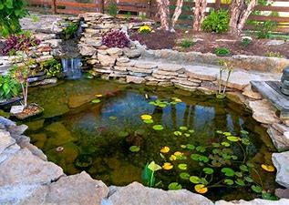

I...
I dea..
Here is an idea to handle this.

Slide 11
from school import scheldule
import weather as wt
weather = wt.temperature(wt.today)
if str(weather) == "hot":
scedules[school] += hour(1)
elif str(weather) == "cold":
scedules[school] -= hour(1)
If, today is hot, school start earlier. And if today is cold, School start later.

Slide 12
I disagree with this idea. So introduce 3 reasons about this.

Slide 13
First, this idea ruins student’s schedule.

Slide 14
Play
EVRSLPW
PPT
Sleep
Homework
Academy
Homework
School
If today’s cold so school start later, schedules are mixing.

Slide 15
And, this idea become not for student

Slide 16

Second, this idea make student more harder than before

Slide 17
Sleep
Homework
Academy
Homework
School
Breaktime
If school start early we have a breaktime

Slide 18
Sleep
Homework
Academy
Homework
Academy^^
Breaktime
School
And academy intervenes.

Slide 19
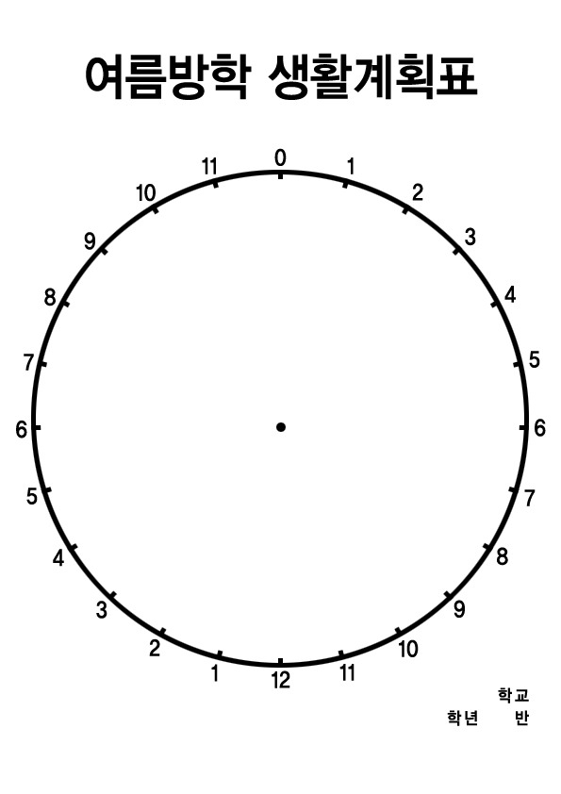
숙
제
학원
잠
숙제
학원
숙제
You can know just see vacation.

Slide 20
Thirdly, this idea never can be fundamental solution

Slide 21
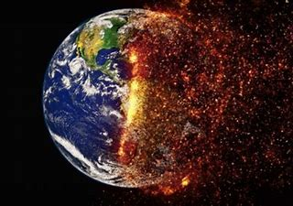
You should attend to global warming that is responsible for this phenomenon.

Slide 22
Thank you for watching my PPT
황준화

